Slide 1
Advanced Topics
WEB SCIENCES
Etienne Raquin
21.05

Slide 2


“If you’re crazy about Strava”
- Dr. Koumpis, 14.05.2019

Slide 3
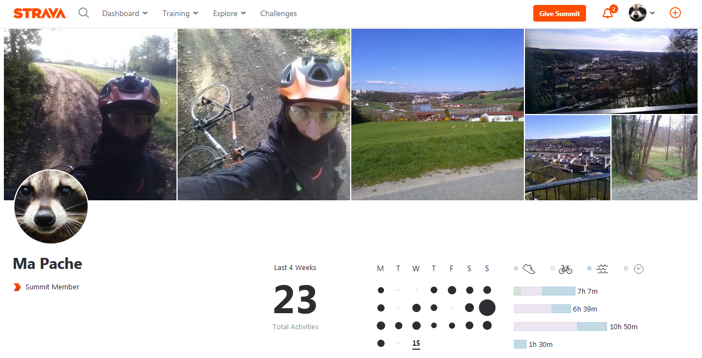
Profile

Slide 4
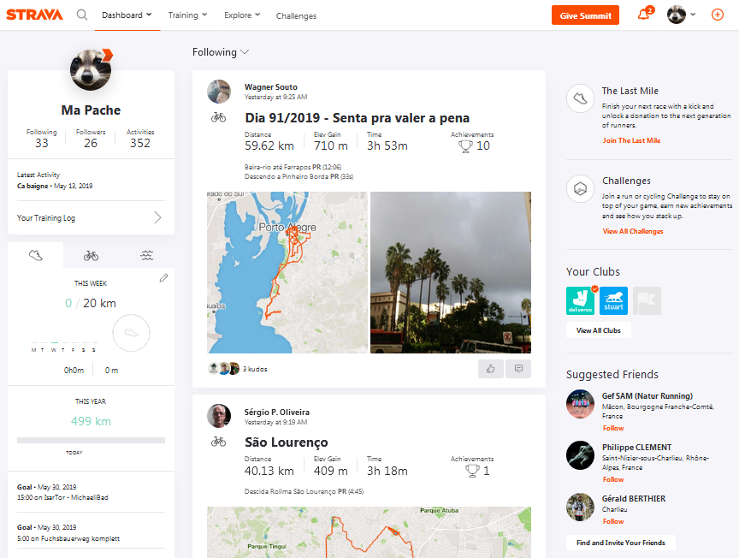
DashBoard

Slide 5
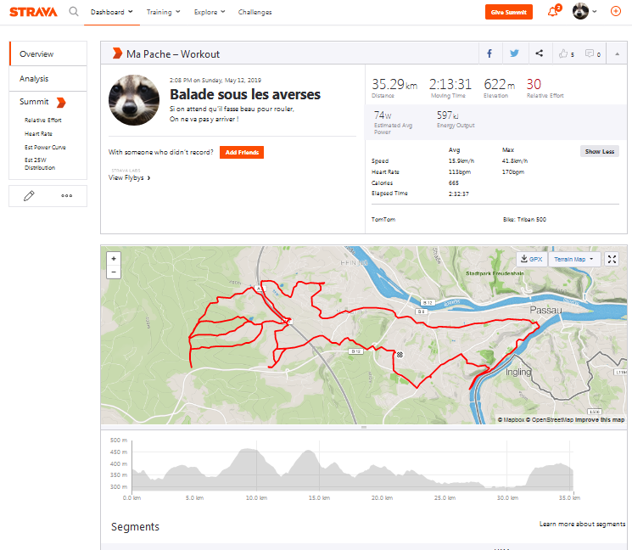
Overview
Activity

Slide 6
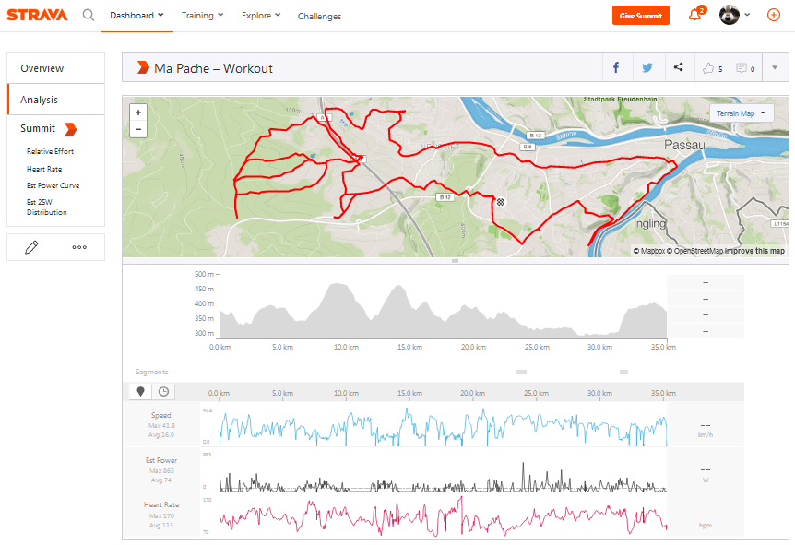
Analysis
Activity

Slide 7
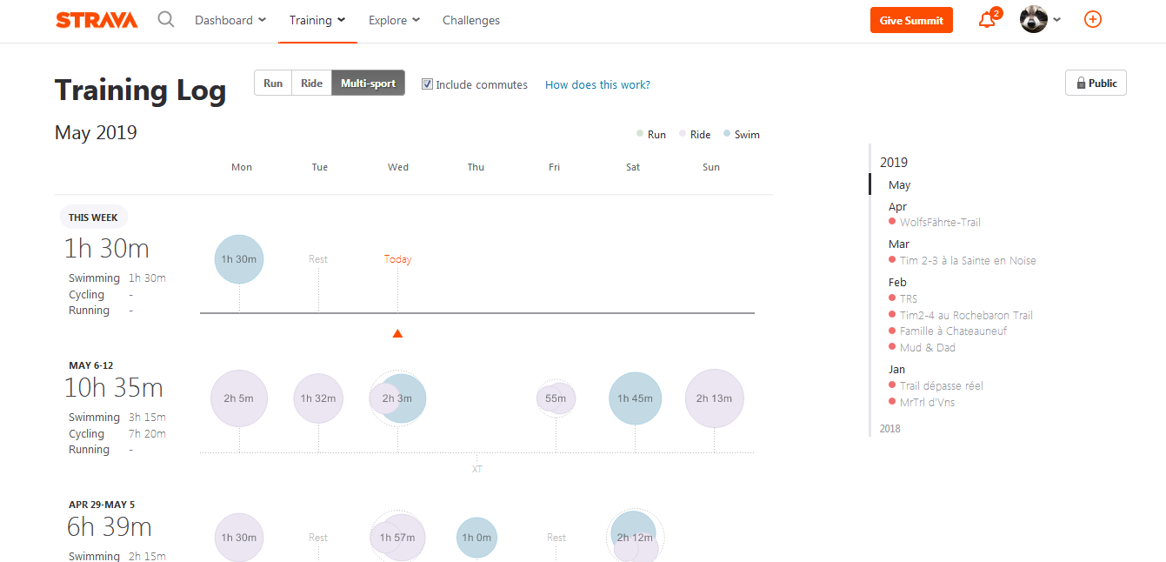
Training Log

Slide 8
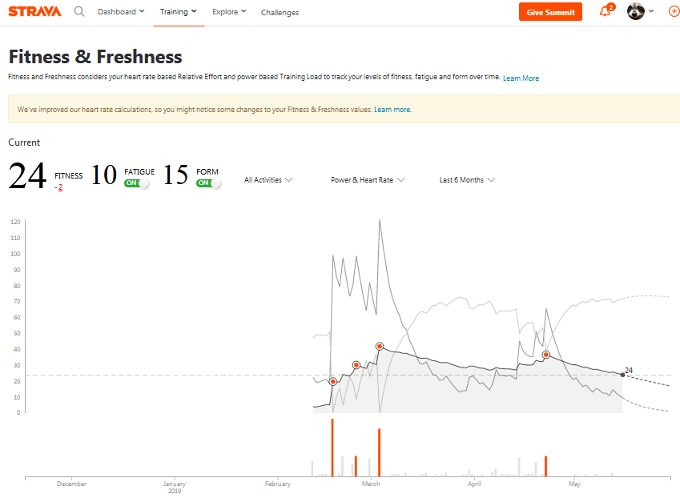
Fitness
Freshness

Slide 9
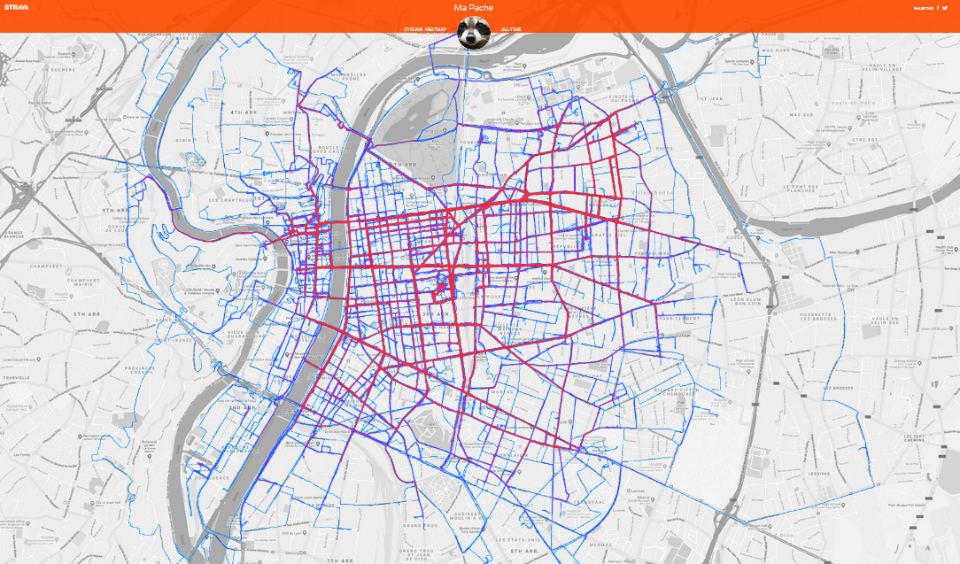
Cycling Lyon
HeatMap

Slide 10
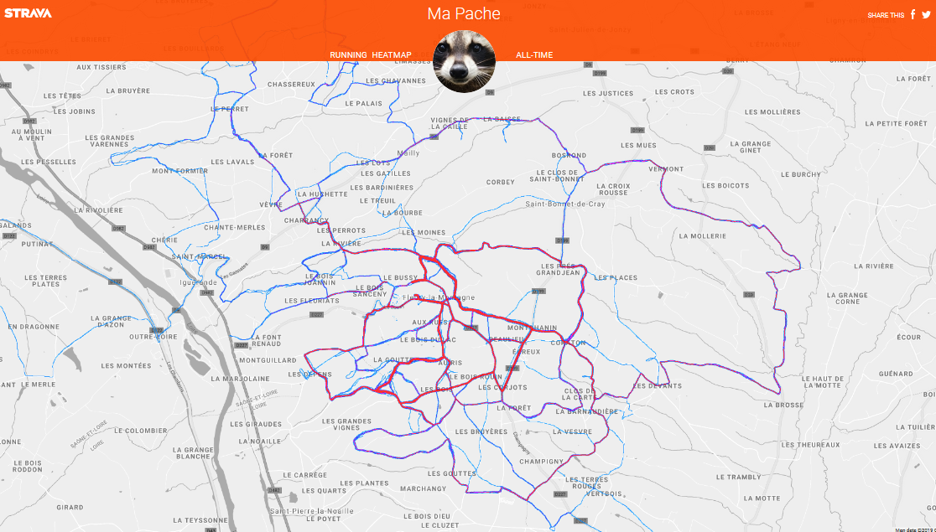
Running Home
HeatMap

Slide 11

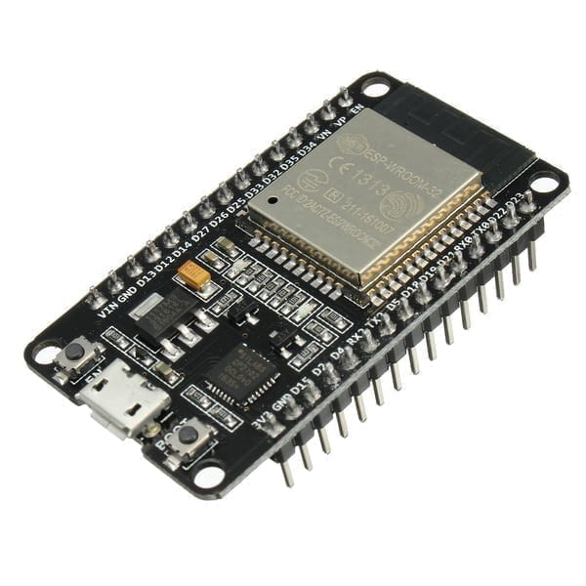
“Interoperability with Scripting
on MicroControllers”

Slide 12
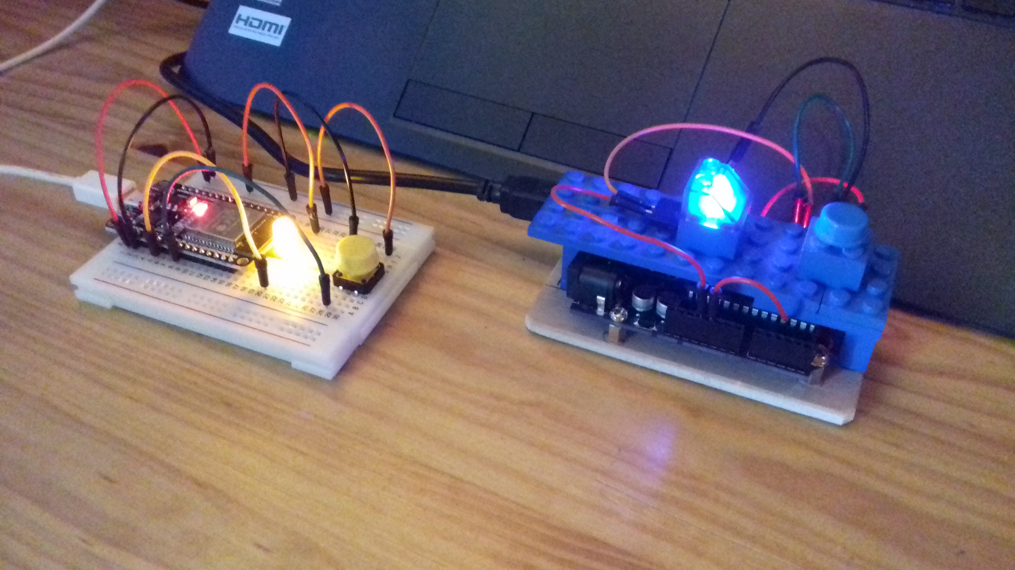
MicroControllers

Slide 13
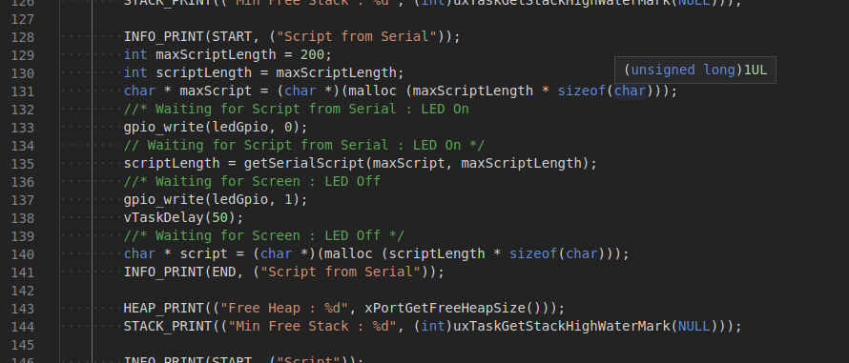
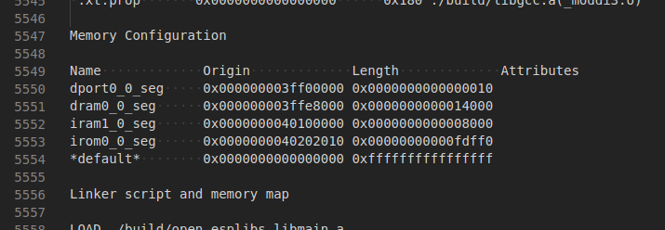
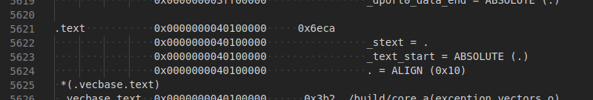
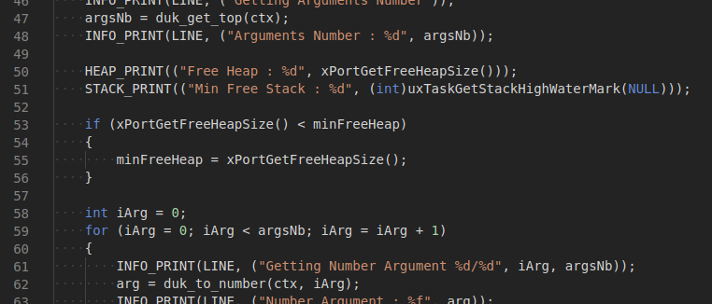
Low Level

Slide 14

HEALTH
“It would be great
if you could do something
related to health”
- Dr. Koumpis, 14.05.2019

Slide 15
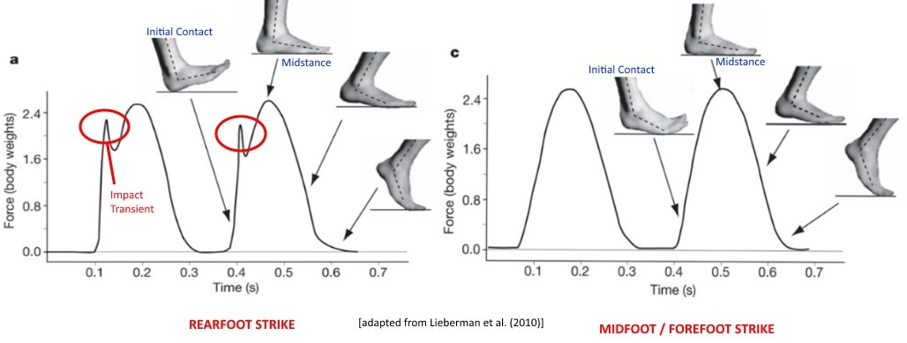
ForeFoot Strike

Slide 16
Improving Health
By enriching Strava Activities
With MicroControllers Data

Slide 17
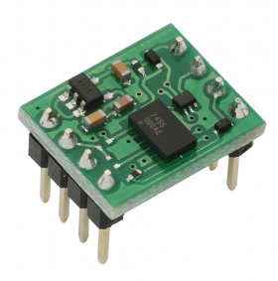
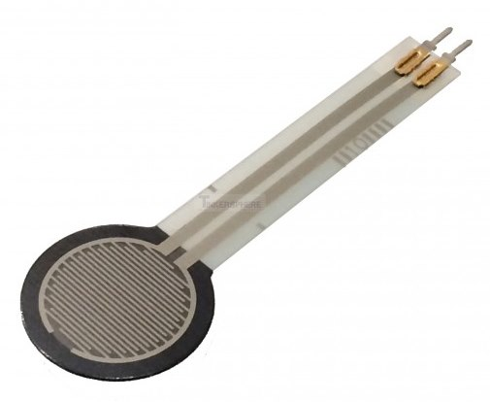
Improving Health
By enriching Strava Activities
With MicroControllers Data
AcceleroMeter
Force Pressure Sensor

Slide 18
Improving Health
By enriching Strava Activities
With MicroControllers Data
Your Opinion ?

